Slide 1

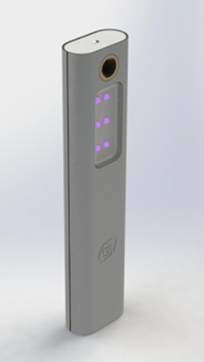
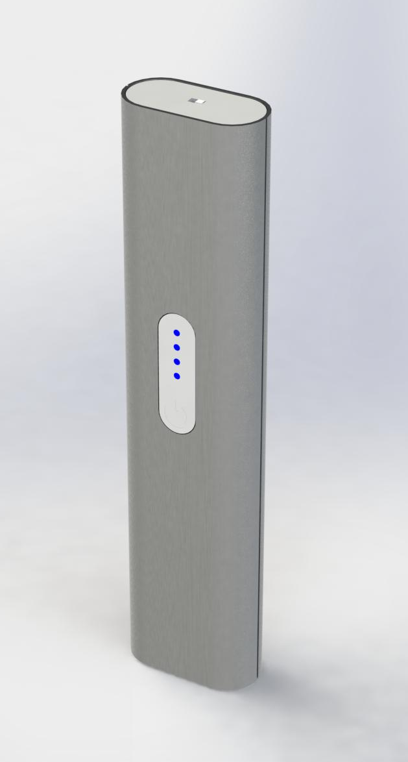
Galaxy Lightart
Portable Ultraviolet Germicidal Lamp
Specifications：
Weight：200g (7oz)
Size: 42x20x180mm (1.7”x0.8”x7”)
Power: 2W
Finishes：Silver/Black/Gold
Material：6063 Aluminum
Charge：TYPE C (USB cable)
Battery Performance：500mAh
UV-C Wave Length：260~270nm
Time of Disinfection：10/20/50 seconds
Distance of Disinfection：3-5cm
LED Life：10000 hours
Safety Protection：G-sensor + Child Lock

Slide 2
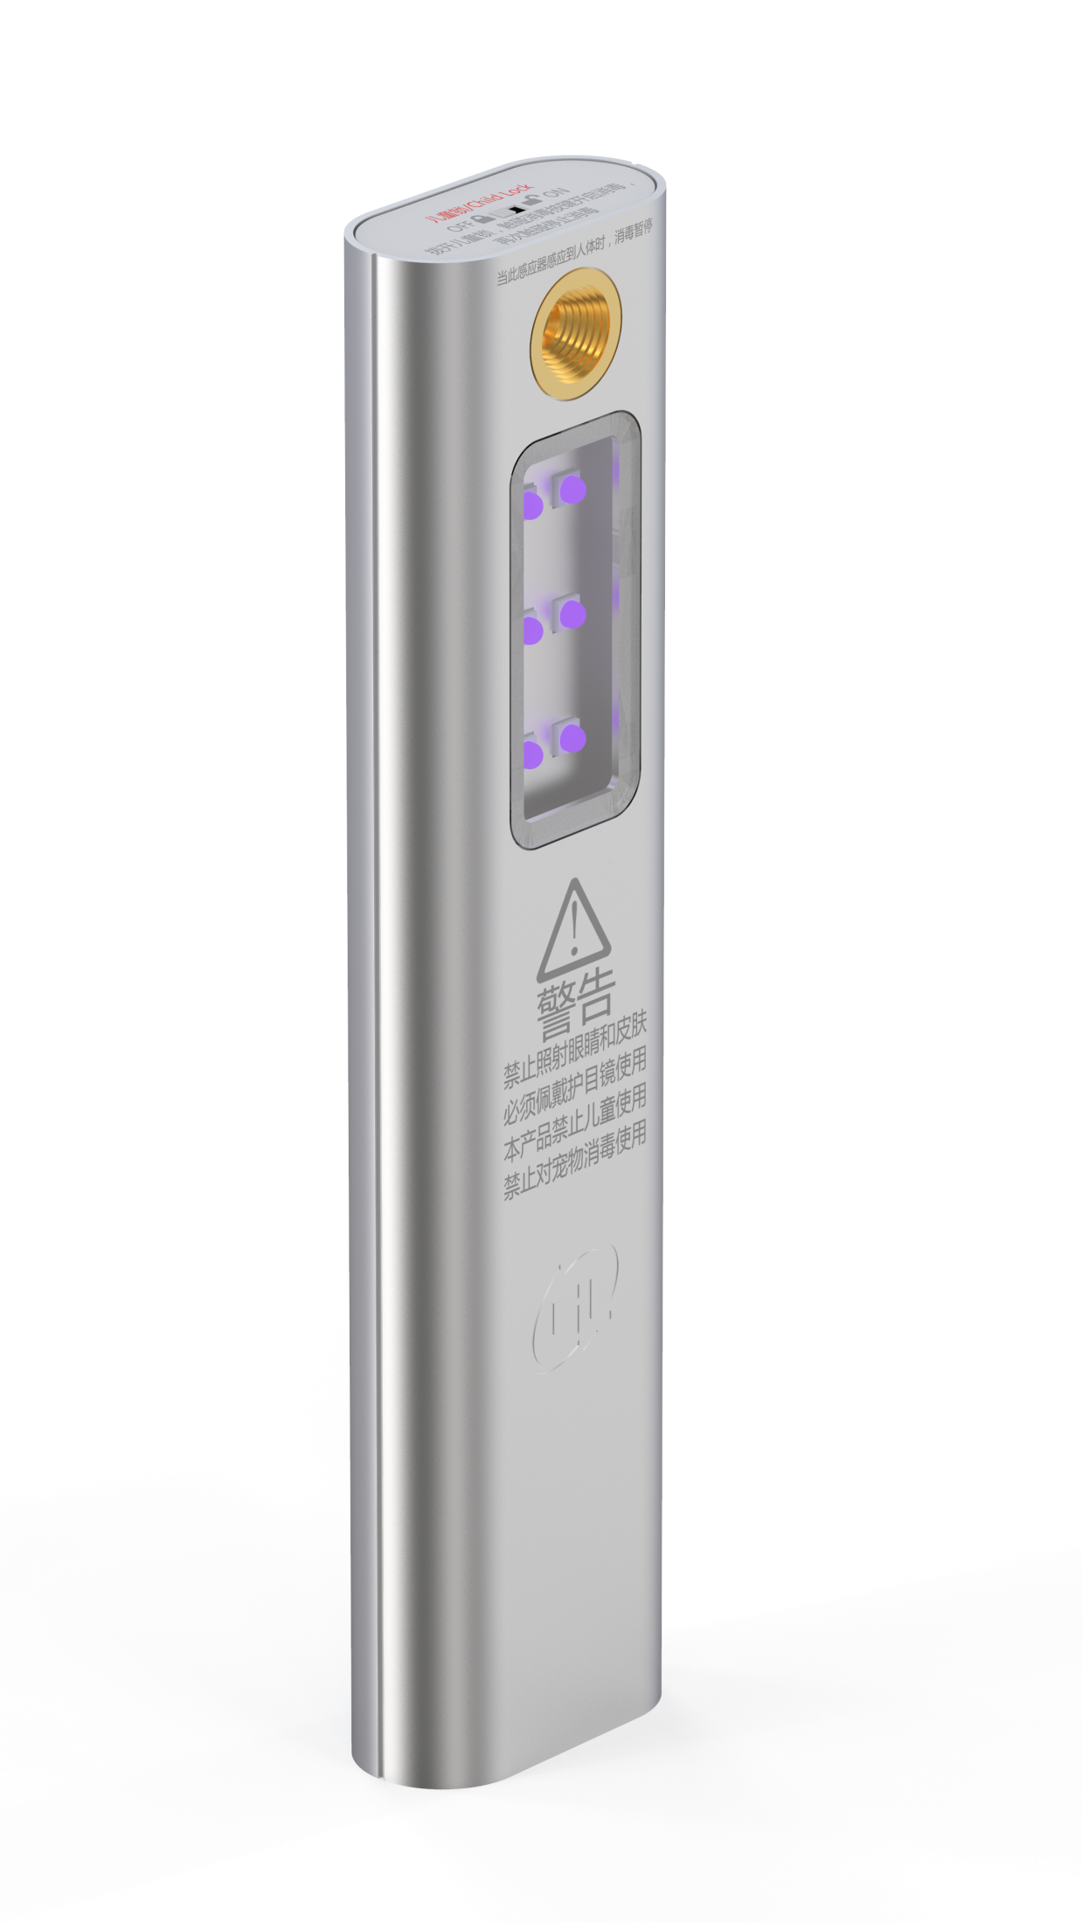
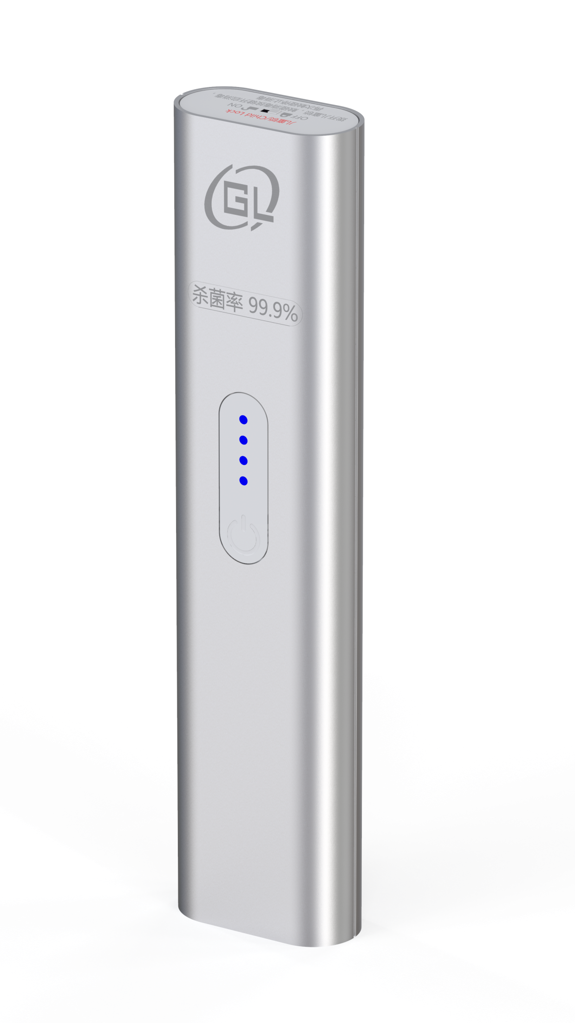
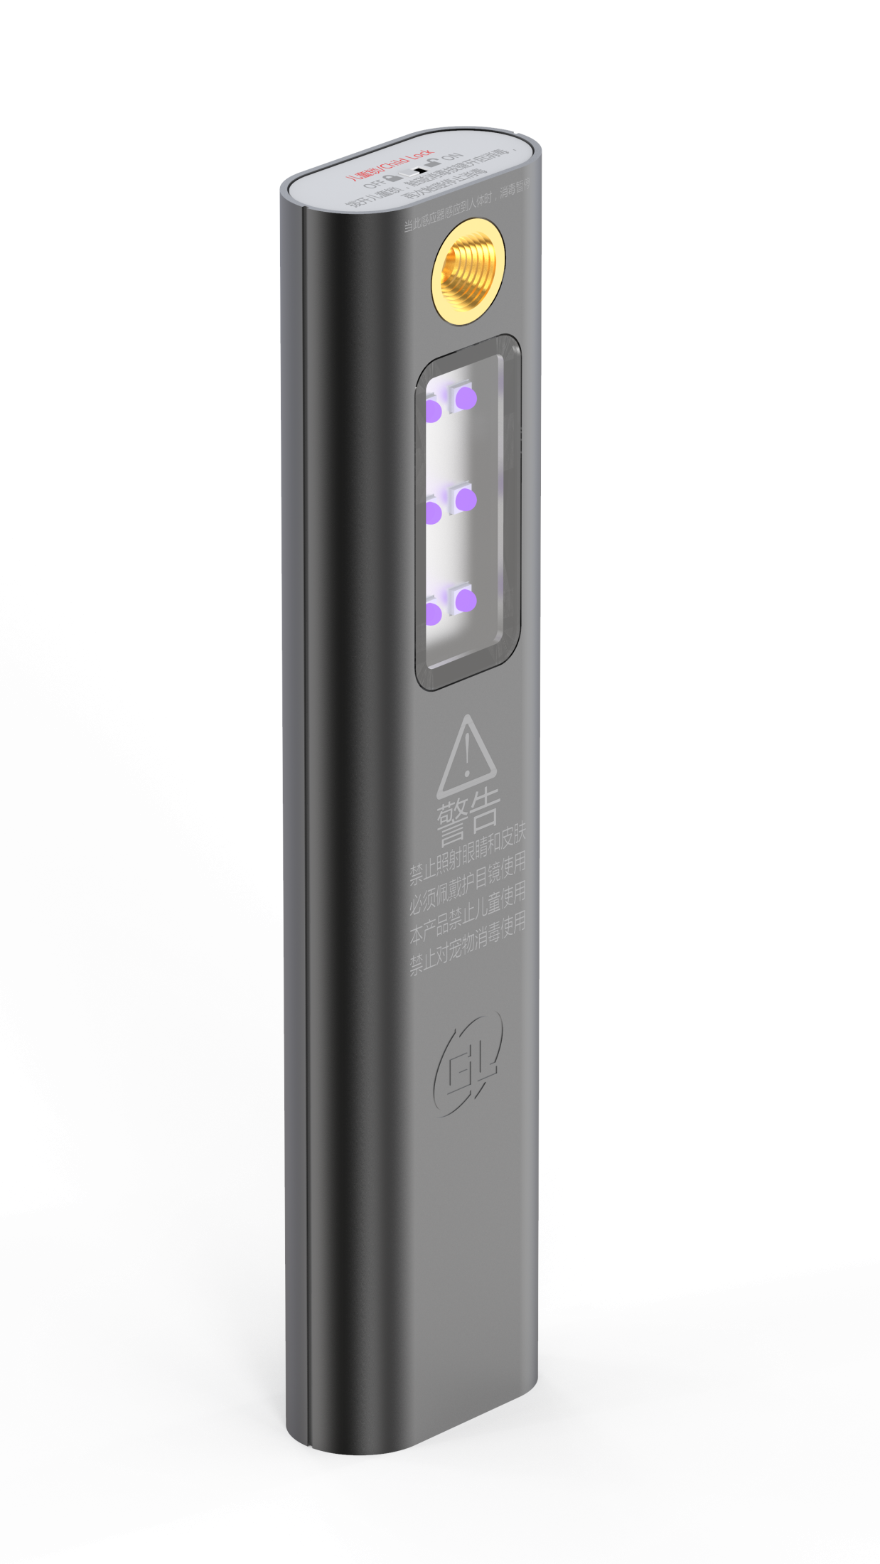
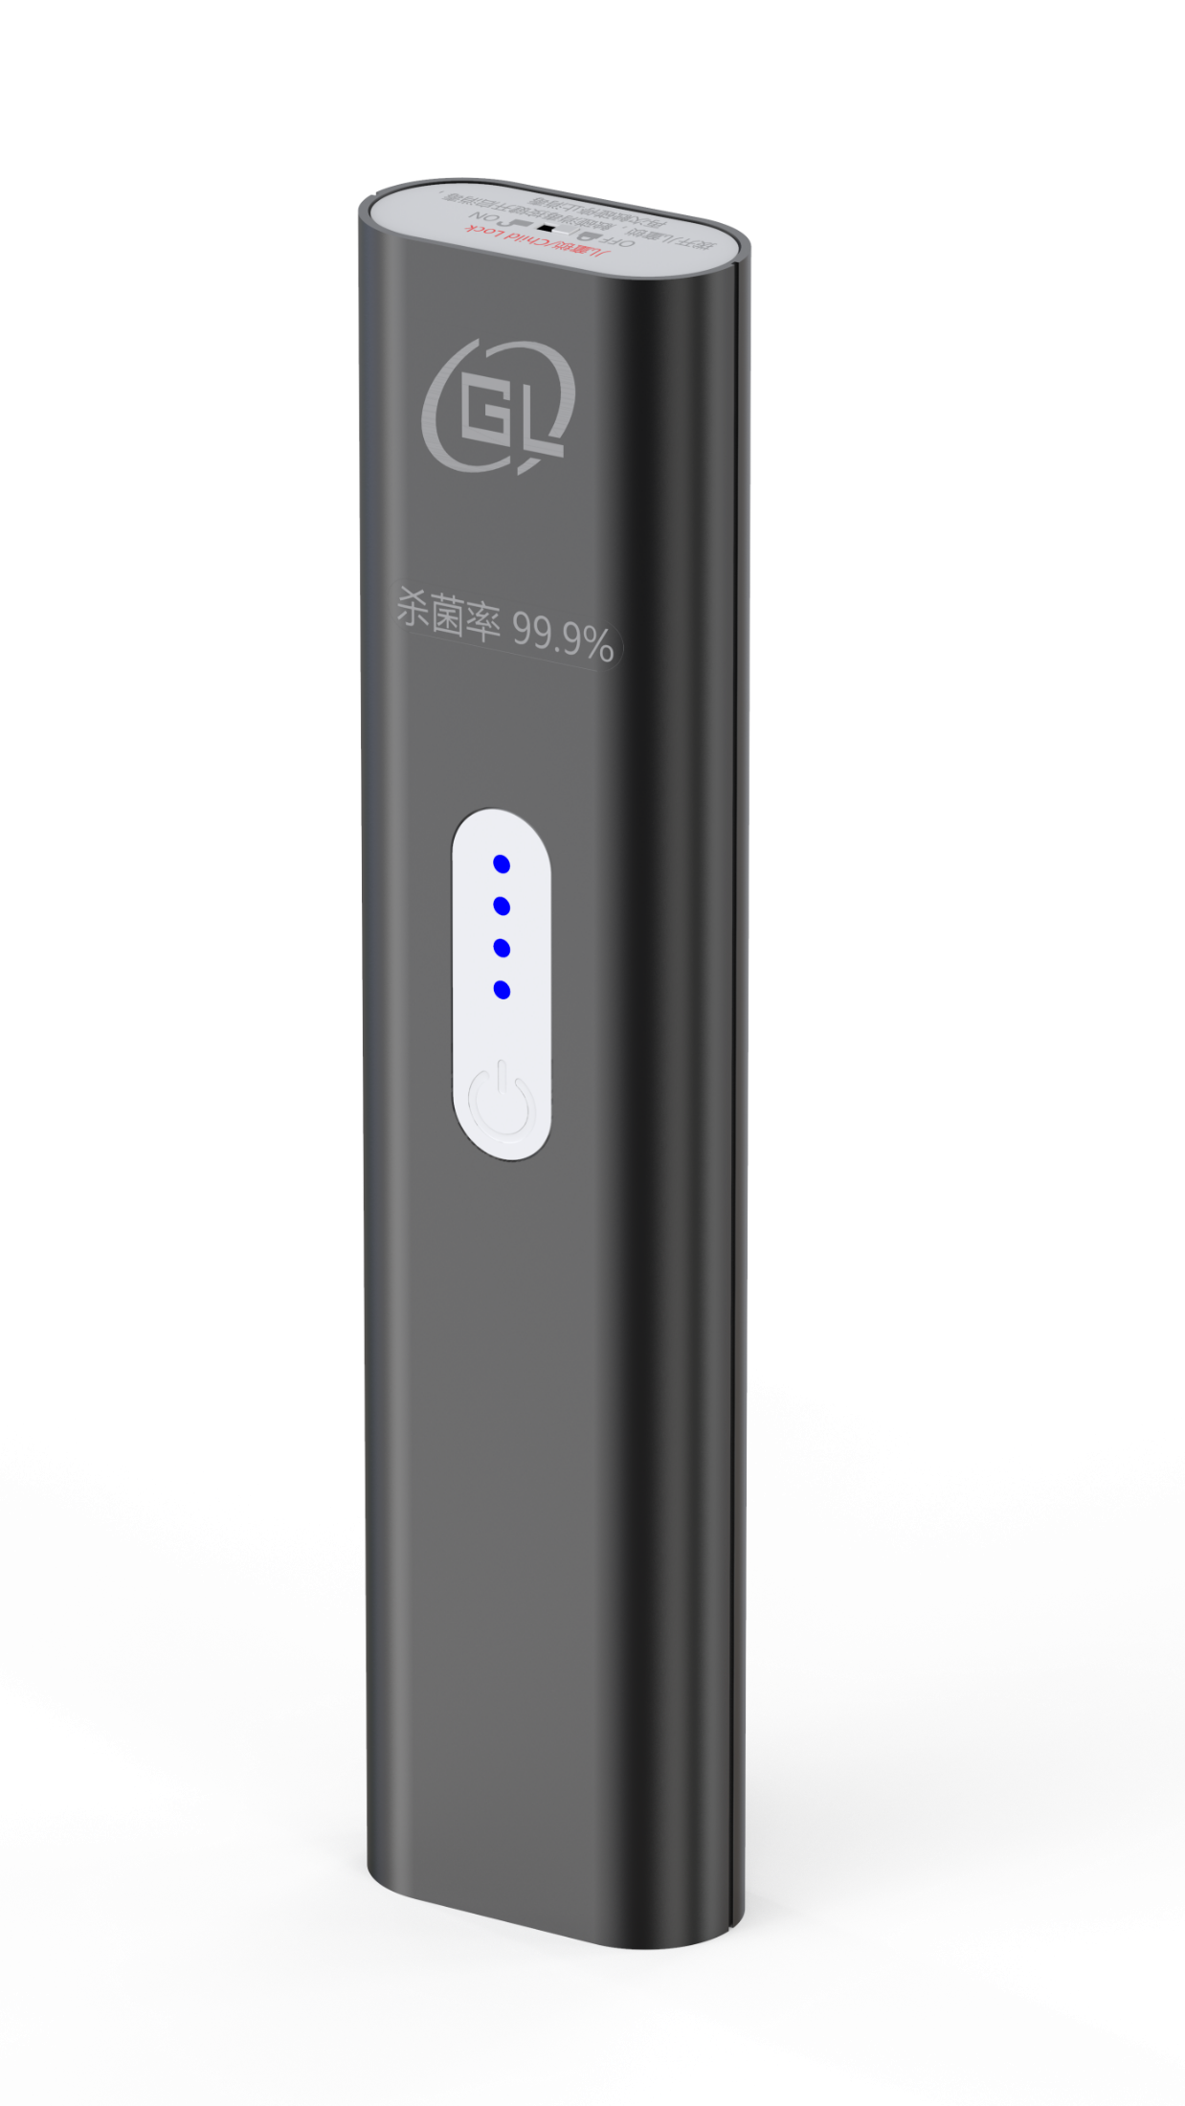
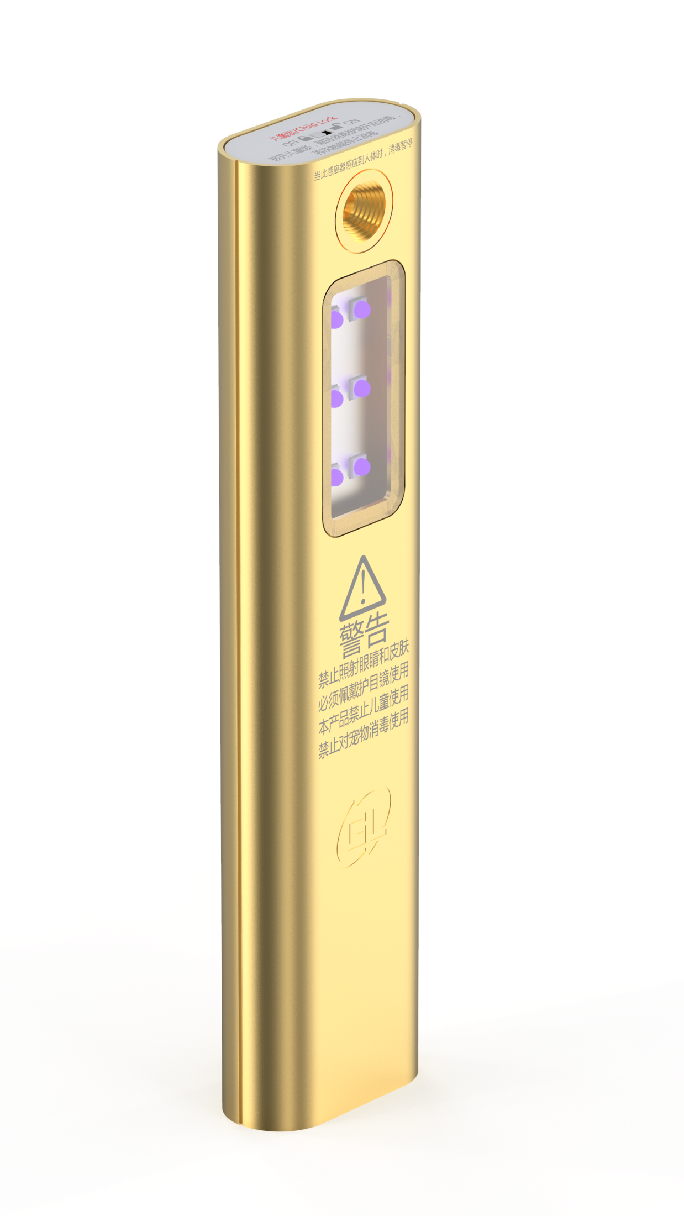
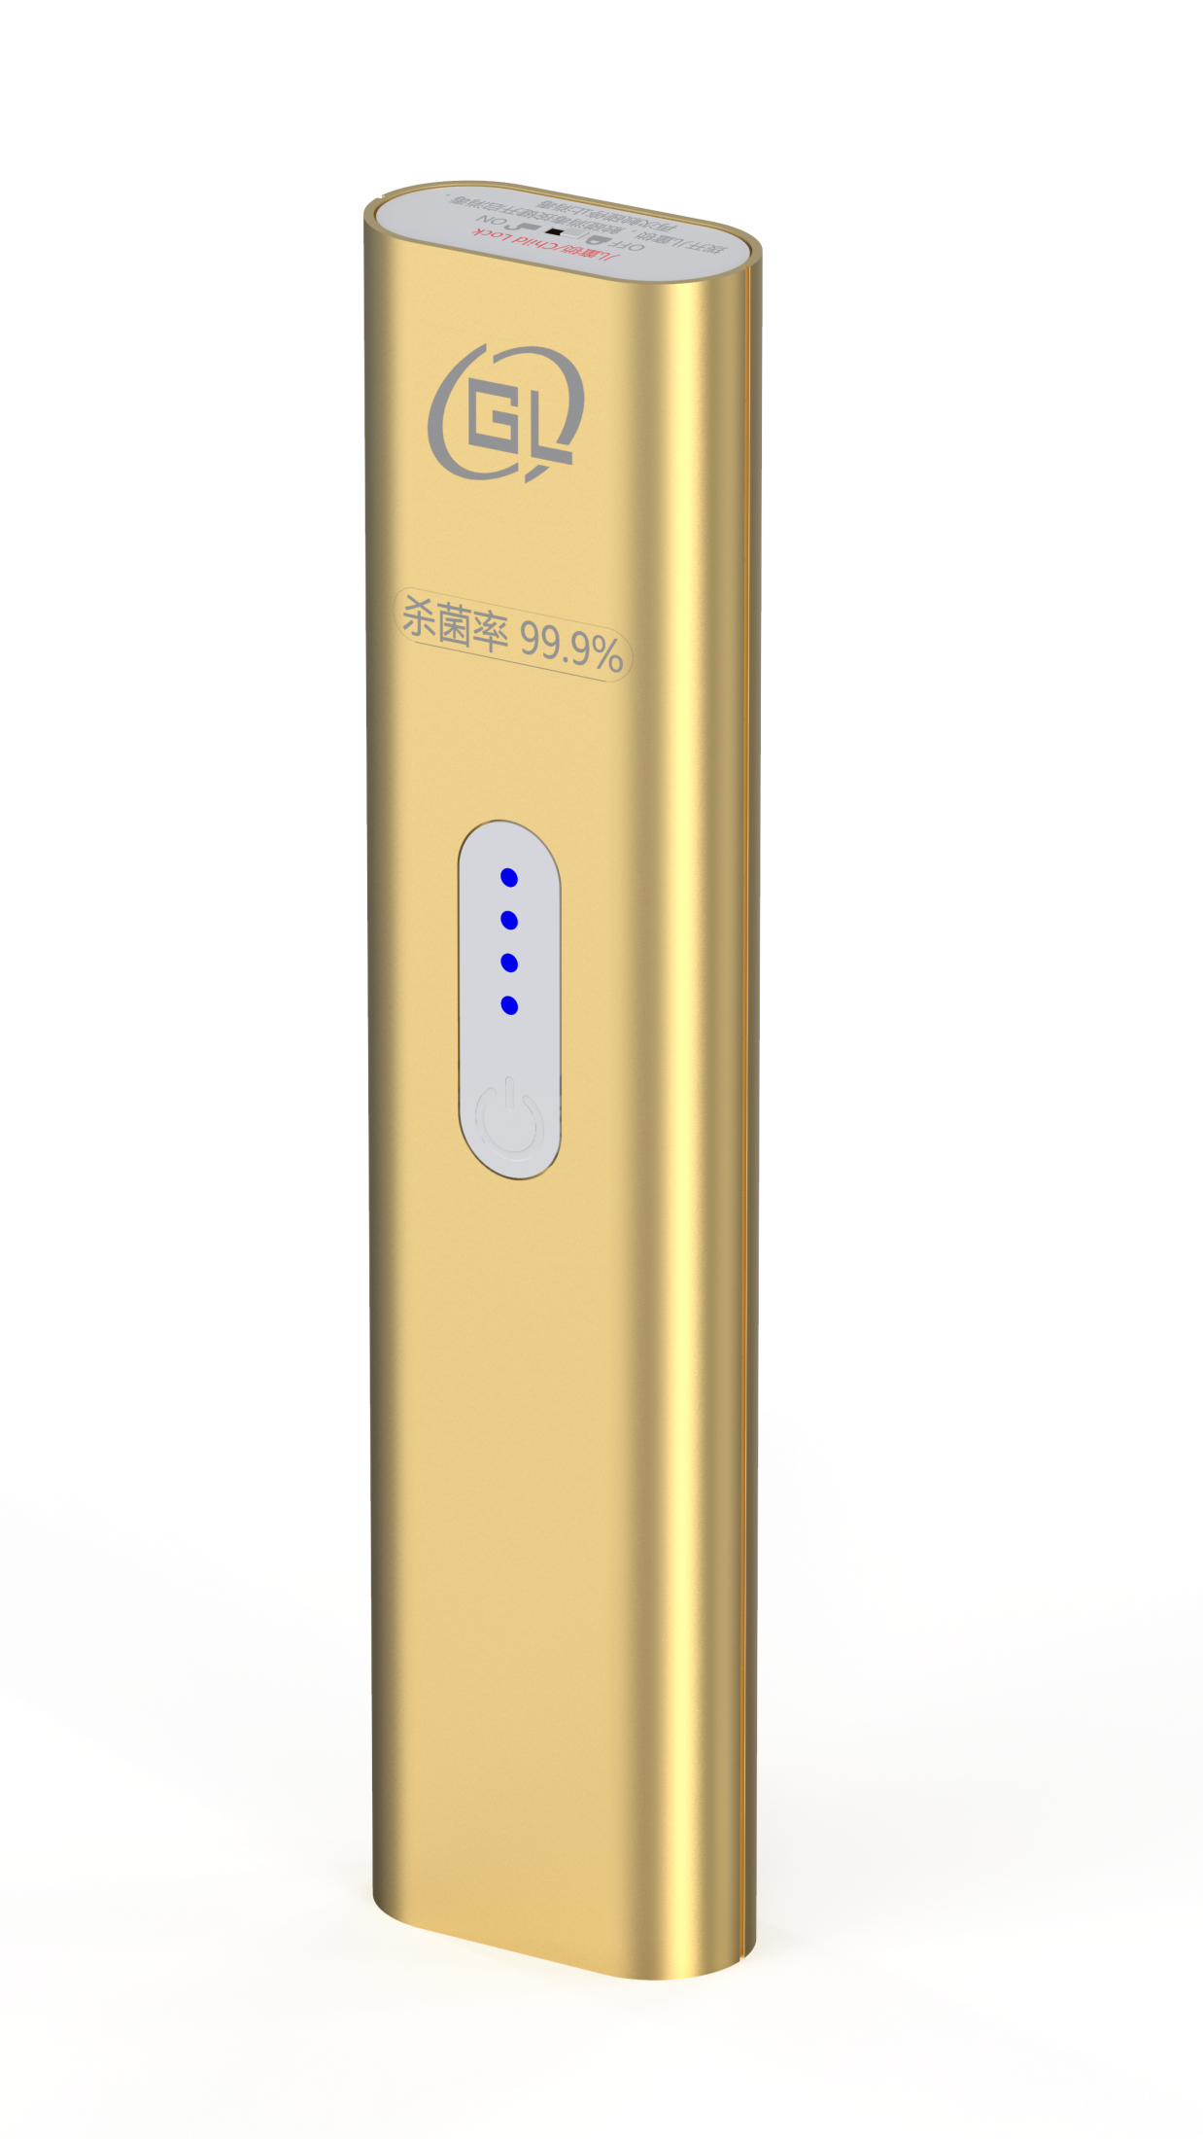
Finishes：
Silver
Black
Gold

Slide 3
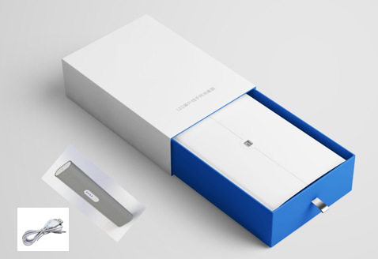
Packaging：

Slide 4
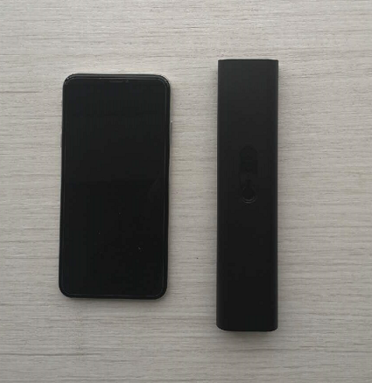

Portable:
Mini portable design.
Convenient for travel.
Mini size
(similar to cell phone)
USB interface
(convenient charging)

Slide 5
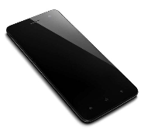
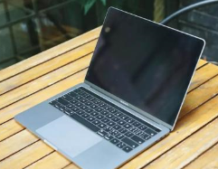

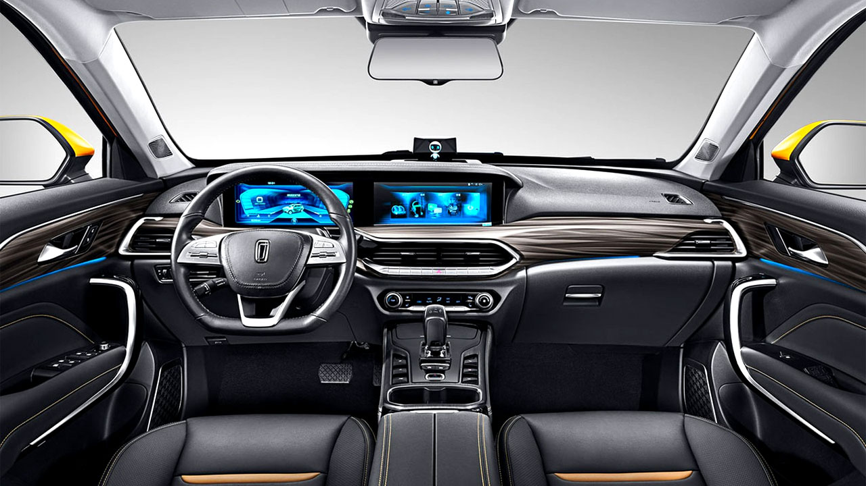

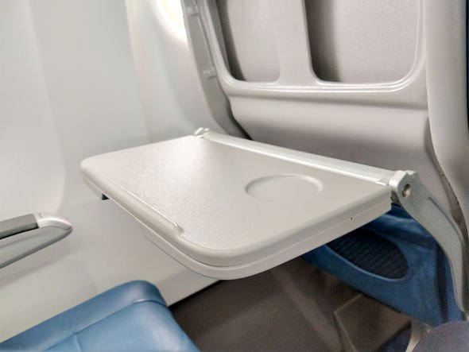

Applications：
Wide range of uses - suitable for home, office, travel etc.
phone
toys
Computer, tablet, etc.
Car interior
Airplane tray table
Shopping cart
Hotel room

Slide 6
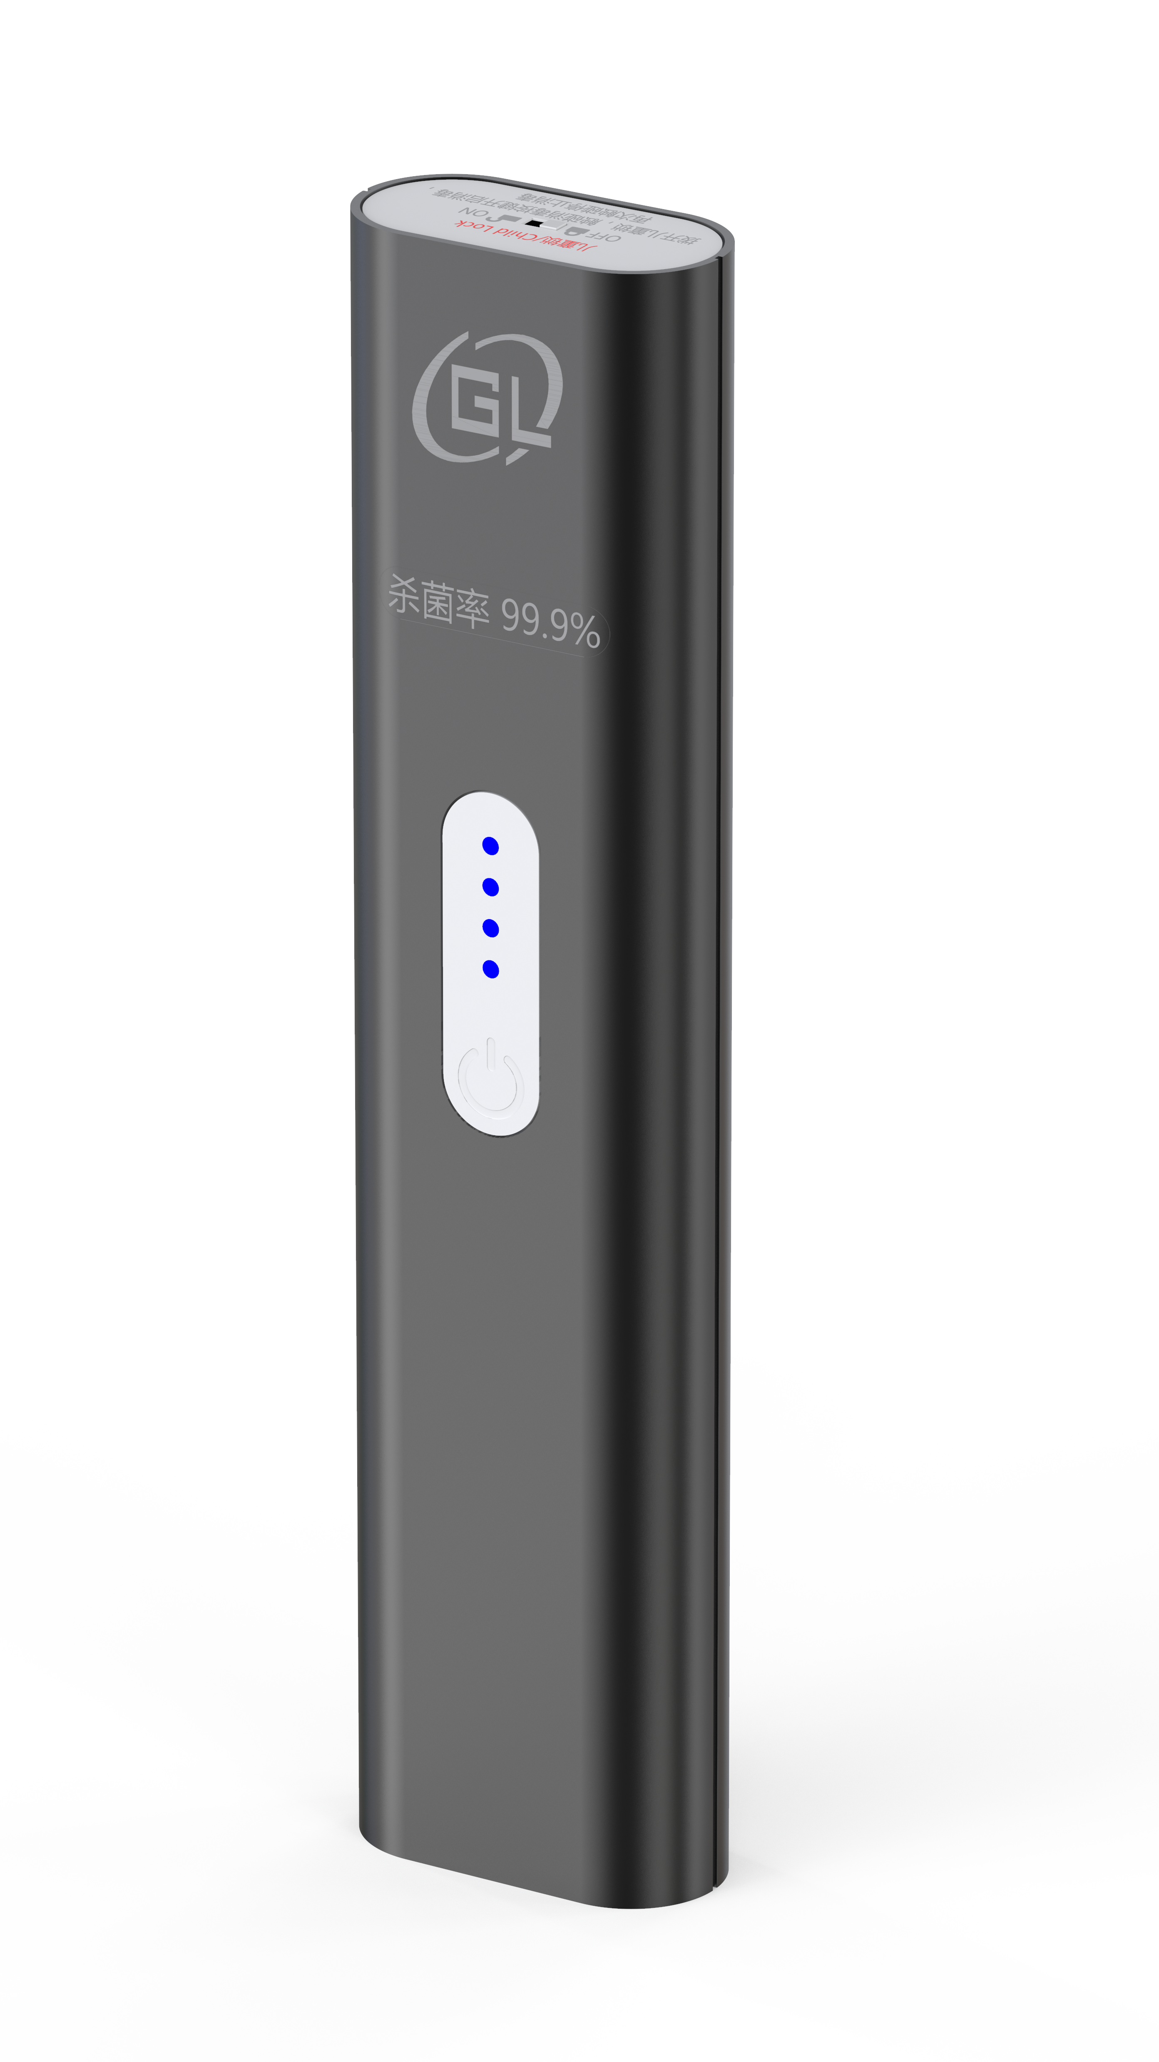
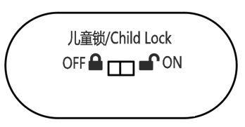
Operations：
First Step:
Turn on “Child Lock”
Safety feature for kids

Slide 7



Operations：
Second Step:
Hold the unit with LED’s facing down, then press the on/off button until the 4 indicator lights turn blue.
Then you can scan the surfaces to be sanitized.
UV light eliminates germs, allergens, virus, etc.

Slide 8
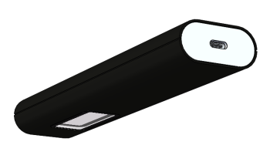
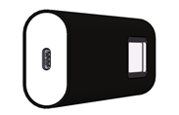
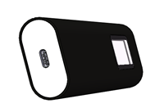
Operations：
Third Step:
Hold UV light about 5cm (2”) away from surface. Disinfect for 10/20/50 seconds, press the on/off button to stop or restart.
UV Light operates properly when facing down.
Unit has a built-in G-sensor. In the working state, the UV Light will turn off automatically when rotated upwards or inclined to ensure user safety.
Normal use facing down
G-sensor
Safety Protection
Critical rotation point
(less than 90°-light on）
(more than 90°-shut off）
Shut off

Slide 9
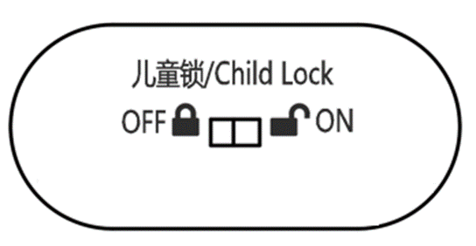
Operations：
Fourth Step:
Turn off the “Child Lock” after finished sterilizing. Then pack and store away from children.
Turn off
“Child Lock”
Keep away
from
children

